Slide 1
Unit 4: For Live Session Assignment
Alternatives to the t-tools!

Slide 2
Part 1

Slide 3
Quick Quiz Questions

Slide 4
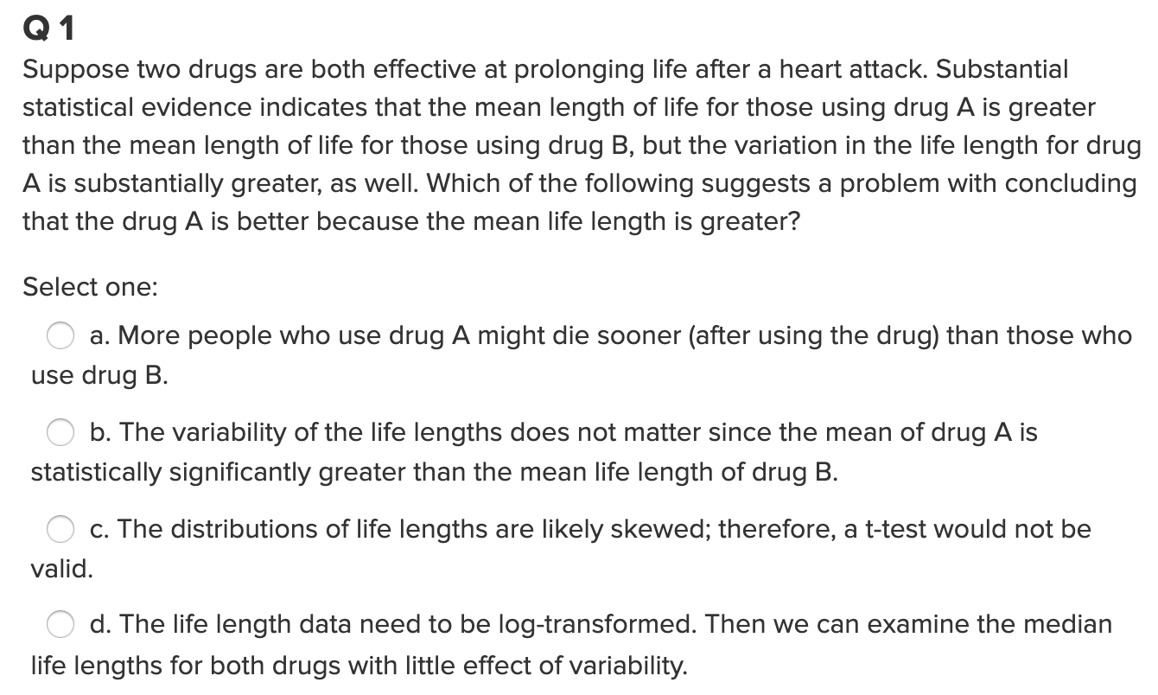
Question 1

Slide 5
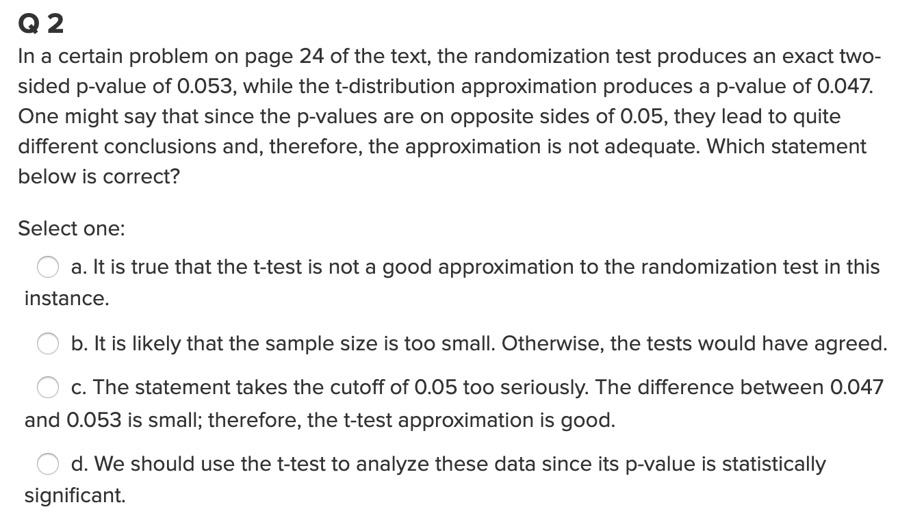
Question 2

Slide 6
End Part 1

Slide 7
Part 2

Slide 8
Question 1 (2 hours)
IBM gives each employee in the marketing department technical training
Based on further testing, it appears the traditional training method isn’t effective
Hence, a new training method is developed
Below are the test scores of 4 individuals who just finished the “New Method” and the last 3 test scores from employees trained via the “Traditional Method” course
Is there evidence to suggest that the “New Method” increases test scores?
A) Address the assumption of a t-test to answer this question.
Perform the test you feel is appropriate given the methods you have learned thus far.
As a reminder: Please clearly address this problem with slides that you will present in breakout and submit those slides to 2DS before live session (preferably 24 hours before.)
New Method | Traditional Method
37 | 23
49 | 31
55 | 46
77

Slide 9
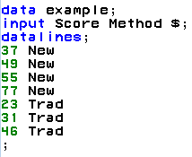
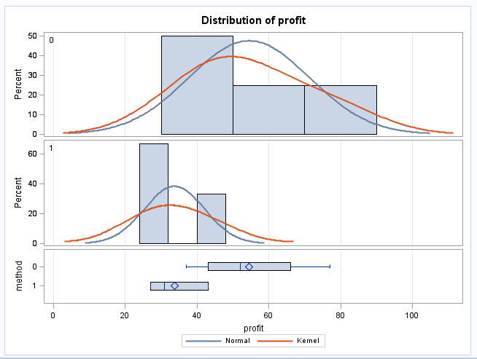
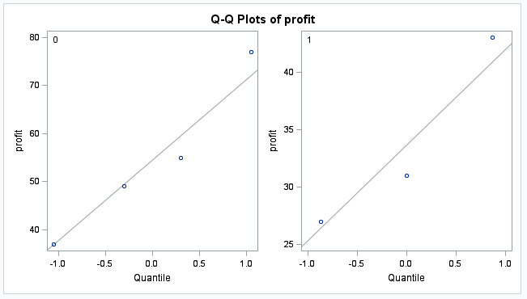
Examining the t-Tools Assumptions
2
2
1
1
Begin in R:
Score<- c(37, 49, 55, 77, 23, 31, 46)
Score
Method <- c("New", "New", "New", "New", "Trad", "Trad", "Trad")
Method
#To combine into one data set if needed
Example_df<-data.frame(Score, Method)
Example_df
Since the standard deviations appear (visual check) to be different and the sample sizes are both different and exceptionally small, the t-test was not deemed appropriate and the nonparametric rank sum test was performed.

Slide 10
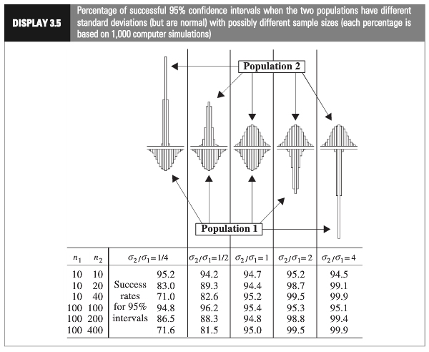
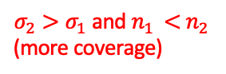
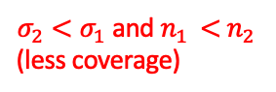
2
1
Which situation does it appear we are in?
$σ_{2}<σ_{1}$ and $n_{1 }<$ $n_{2 }$
(less coverage)
$σ_{2}>σ_{1}$ and $n_{1 }<$ $n_{2 }$
(more coverage)
Using a t-test could have low power.
Notes:
Worst case: the variance from the larger group is smaller than the variance from smaller group:

Slide 11
Nonparametric Methods: The Rank Sum Test

Slide 12
Nonparametric Methods
A nonparametric or distribution-free test doesn’t depend on underlying assumptions
This makes them ideal for use when the assumptions of non-nonparametric (that is, parametric) tests aren’t met
The trade-off is that nonparametric methods perform somewhat worse than parametric methods if the assumptions are approximately correct
The first nonparametric method we will consider is the ”rank sum test”

Slide 13
Rank Sum Test: Advantages
No distributional assumptions
Resistant to outliers
Performs nearly as well as the t-test when the two populations are normal and considerably better when there are extreme outliers
Works well with ordinal (as opposed to interval data)
Works with censored values
It still requires some assumptions:
All observations are independent
The Y values are ordinal
59 patients with arthritis who participated in a clinical trial were assigned to two groups, active and placebo. The response status:
(excellent=5, good=4, moderate=3, fair=2, poor=1)
of each patient was recorded.

Slide 14
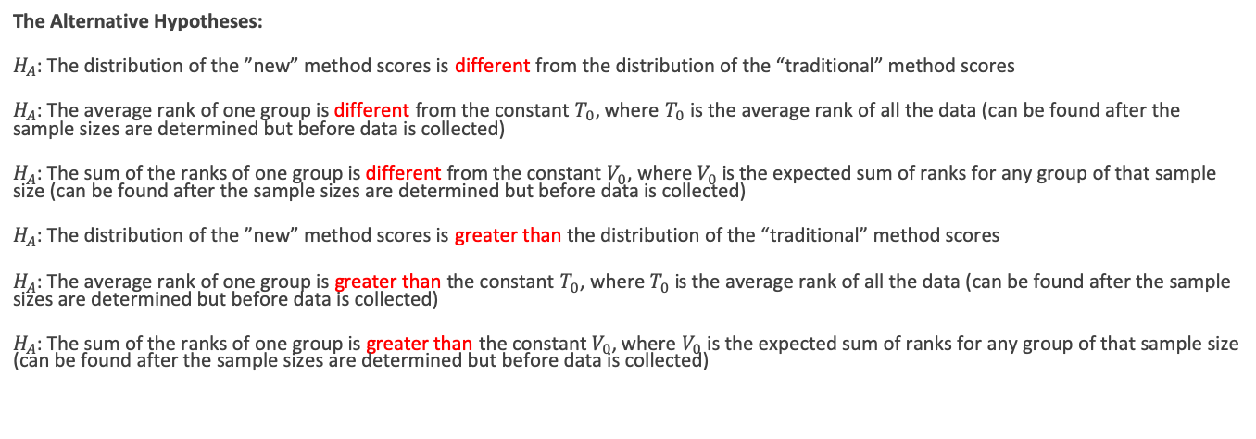
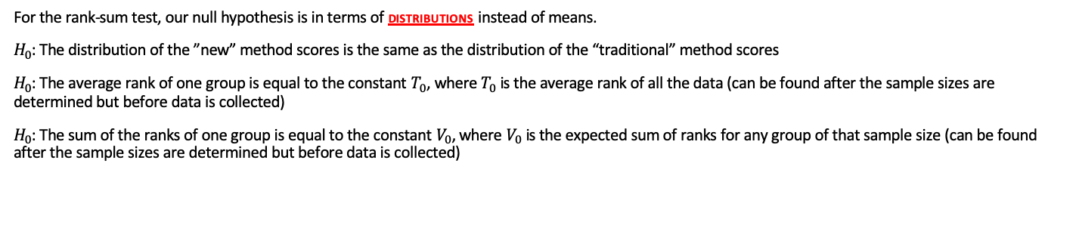
The Hypothesis Test
For the rank-sum test, our null hypothesis is in terms of distributions instead of means.
$H_{0}$: The distribution of the ”new” method scores is the same as the distribution of the “traditional” method scores
$H_{0}$: The average rank of one group is equal to the constant $T_{0}$, where $T_{0}$ is the average rank of all the data (can be found after the sample sizes are determined but before data is collected)
$H_{0}$: The sum of the ranks of one group is equal to the constant $V_{0}$, where $V_{0}$ is the expected sum of ranks for any group of that sample size (can be found after the sample sizes are determined but before data is collected)
The Alternative Hypotheses:
$H_{A}$: The distribution of the ”new” method scores is different from the distribution of the “traditional” method scores
$H_{A}$: The average rank of one group is different from the constant $T_{0}$, where $T_{0}$ is the average rank of all the data (can be found after the sample sizes are determined but before data is collected)
$H_{A}$: The sum of the ranks of one group is different from the constant $V_{0}$, where $V_{0}$ is the expected sum of ranks for any group of that sample size (can be found after the sample sizes are determined but before data is collected)
$H_{A}$: The distribution of the ”new” method scores is greater than the distribution of the “traditional” method scores
$H_{A}$: The average rank of one group is greater than the constant $T_{0}$, where $T_{0}$ is the average rank of all the data (can be found after the sample sizes are determined but before data is collected)
$H_{A}$: The sum of the ranks of one group is greater than the constant $V_{0}$, where $V_{0}$ is the expected sum of ranks for any group of that sample size (can be found after the sample sizes are determined but before data is collected)
(Two sided)
(one sided)
*Note: We can still make one sided conclusion (greater/less than) with the two sided test. It is essentially testing the two sides at once.

Slide 15
The Rank Sum test
We can compute the rank sum test statistic using the following steps:
List all observations from both groups in increasing order
Assign each observation a rank, from 1 to n
If there are any ties, assign each tied observation’s rank to be the average of their ranks.
Identify each observation by its group
The test statistic, T, is the sum of the ranks in one of the groups.
We can find a p-value in two ways:
Normal approximation
Re-randomization (exact or approximate)
Note: n is the total # of observations

Slide 16
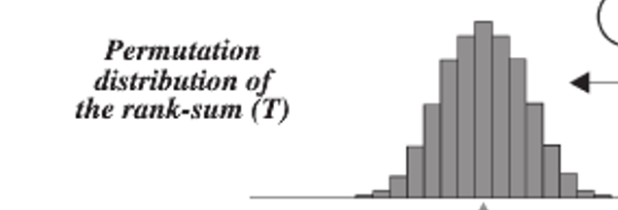
The Sampling Distribution of …
The Rank Sum Statistic!
Rank Sum test statistic (sum of ranks of one group) is approximately normally distributed!

Slide 17
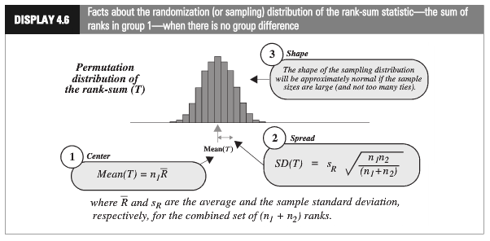
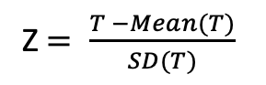
Rank-Sum Test: Normal Approximation
Z $= \frac{T −Mean(T)}{SD(T)}$

Slide 18
Rank Sum Test: randomly assign ranks (or positions)
Name | Order # | Group | Rank
Bob | 1 | New | 5
Sue | 2 | New | 7
Fred | 3 | New | 2
Jim | 4 | New | 1
Pam | 5 | Trad | 3
Tim | 6 | Trad | 4
Zac | 7 | Trad | 6
Name | Order # | Group | Rank
Sue | 1 | New | 7
Bob | 2 | New | 5
Fred | 3 | New | 2
Jim | 4 | New | 1
Pam | 5 | Trad | 3
Tim | 6 | Trad | 4
Zac | 7 | Trad | 6
Name | Order # | Group | Rank
Pam | 1 | New | 3
Tim | 2 | New | 4
Sue | 3 | New | 7
Zac | 4 | New | 6
Fred | 5 | Trad | 2
Bob | 6 | Trad | 5
Jim | 7 | Trad | 1
Record sum of ranks of one group for all 7! permutations of ranks. (7!=7*6*5*4*3*2*1)
P-value is the number of permutations with a sum equal to or more extreme than the one in the original data set divided by the total number of permutations.
*Could also do an approximate p-value by randomly choosing, say, 1000 orderings of the data.

Slide 19
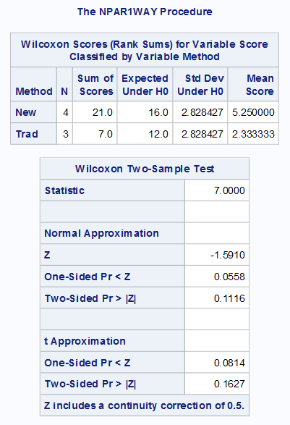
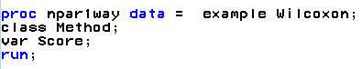
Rank-Sum Test: Normal Approximation
Common interpretation:
H₀: The distribution of New Method Scores = The distribution of the Traditional Method Scores
H₁:The distribution of New Method Scores > The distribution of the Traditional Method Scores
Technical mathematical interpretation:
H₀: Average rank of New Method Scores = Average rank of all Scores (constant)
H₁: Average rank of New Method Scores > Average rank of all Scores (constant)
R Code: wilcox.test(Score~Method, exact=FALSE, alternative = "greater")
There is mild evidence (alpha = 0.1) to suggest that the distribution of scores from the “New” method is greater than the distribution of the “Traditional” method (normal approximation to rank-sum test p-value = 0.0558).

Slide 20
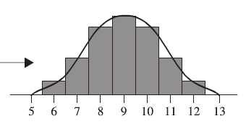
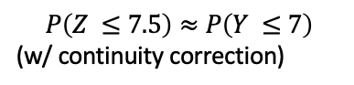
Continuity Correction: Main Idea
$P\left(Z ≤7\right)$ for a continuous Z is much smaller than $P\left(Y ≤7\right)$ for integer Y, (no continuity correction)
$$P\left(Z ≤7.5\right)≈P\left(Y ≤7\right)$$
(w/ continuity correction)
The exact probability calculation for $P(Y ≤7)$ when Y is an integer.

Slide 21
Rank-Sum Test: Normal Approximation
Common interpretation:
H₀: The distribution of New Method Scores = The distribution of the Traditional Method Scores
H₁:The distribution of New Method Scores > The distribution of the Traditional Method Scores
There is mild evidence (alpha = 0.1) to suggest that the distribution of scores from the “New” method is greater than the distribution of the “Traditional” method (normal approximation to rank-sum test p-value = 0.0558).

Slide 22
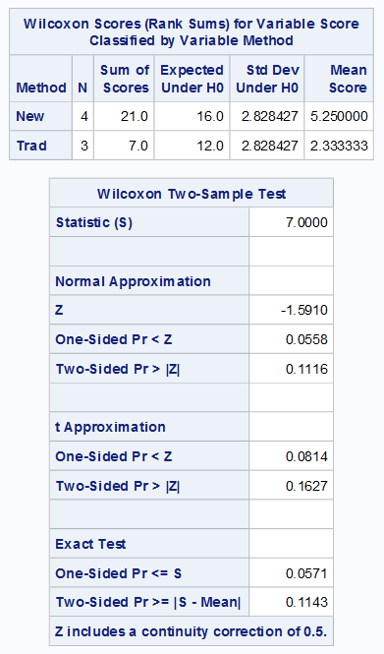
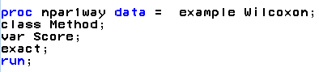
Permutation Test (Exact P-value)
Normal approximation p-values
Exact p-values
In R:
wilcox.test(Score~Method, alternative = "two.sided")
#OR
wilcox.test(Score~Method, exact = TRUE, alternative = "two.sided")

Slide 23
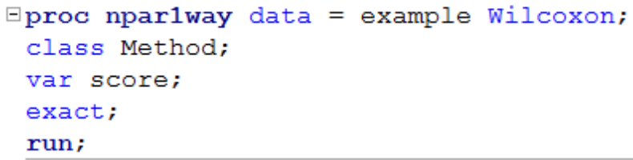
Rank Sum Test (Wilcoxon)
H₀: The distribution of New Method Scores = The distribution of the Traditional Method Scores
H₁:The distribution of New Method Scores > The distribution of the Traditional Method Scores
Critical Value: -1.645
There is sufficient evidence at the alpha = 0.1 level of significance (p-value = .0571 for the exact test) to suggest that the distribution of scores from four IBM employees that were given the New Method is greater than the distribution of the 3 employees that took the test having had the Traditional Method of instruction.

Slide 24
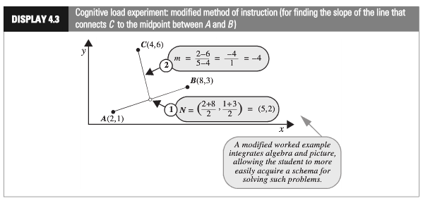
Cognitive Load Experiment
Researchers compared the effectiveness of conventional textbook examples to modified ones
They selected 28 ninth-year students who had no previous exposure to coordinate geometry
The students were randomly assigned to one of two self study instructional groups, using conventional and modified instructional materials
After instruction, they were given a test and the time to complete one of the problems was recorded.
Is there sufficient evidence to suggest that the cognitive load theory (modified instruction) shortened response times?

Slide 25
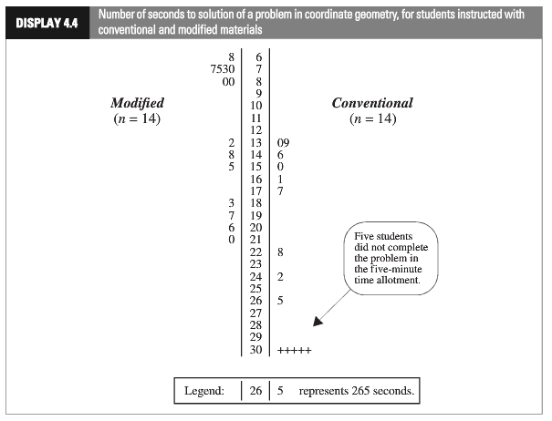
Cognitive Load Experiment
(censored data)

Slide 26
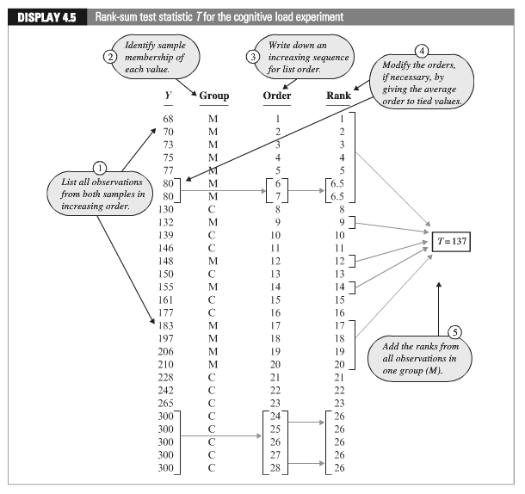
Cognitive Load Experiment
With ties, the ranks are averaged.

Slide 27
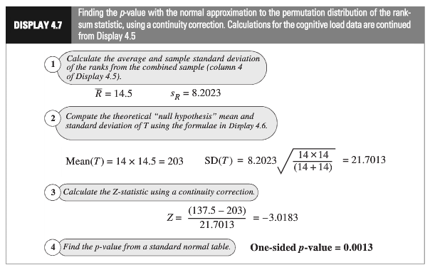
Cognitive Load Experiment: Normal Approximation
(continuity correction)
Statistical Conclusion: The data provide convincing evidence that a student could solve the problem more quickly after the “modiﬁed” rather than the the “conventional” method (one-sided, normal approximation w/ C.C. p-value = 0.0013, from the rank-sum test).

Slide 28
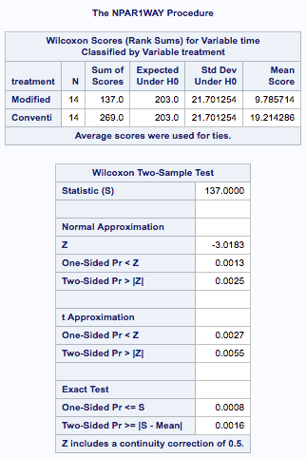
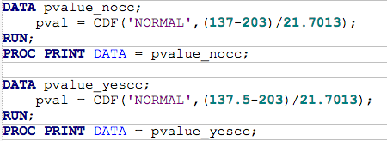
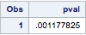
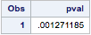
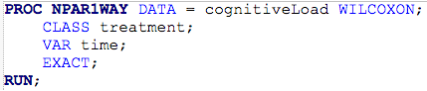
Cognitive Load Experiment: Using SAS

Slide 29
Confidence Interval for the Location Parameter (Median): Hodges Lehman Confidence Interval
https://en.wikipedia.org/wiki/Hodges%E2%80%93Lehmann_estimator
*We will look at an example later

Slide 30
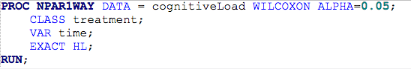
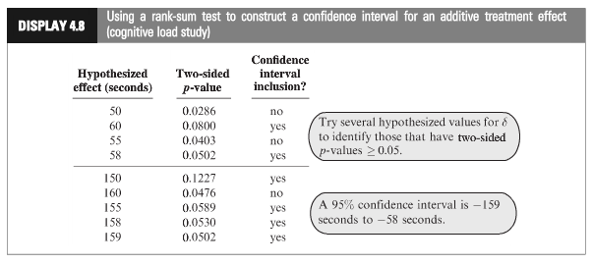
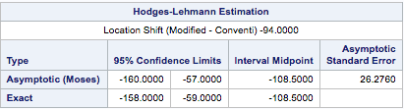
Cognitive Load Experiment
In R: wilcox.test(Score~Method, exact = TRUE, alternative = "two.sided", conf.int = TRUE)
Statistical Conclusion (continued): A range of plausible values for how much smaller the “modified” distribution is than the “traditional” (treatment effect) is [-158, -59] s. (95% conﬁdence interval based on a rank-sum test) with a point-estimate of 108.5 s.

Slide 31
Cognitive Load Experiment (All Together)
H₀: Distribution of Modified and Conventional Scores are equal
H_{a}: Distribution of Modified Scores is less than that of Conventional
Critical Value (left sided): -1.645 (alpha = .05)
Test Statistic: z-stat = -3.0183
P-value (left sided)= .0013
Reject H₀
Statistical Conclusion (continued): The data provide convincing evidence that a student could solve the problem more quickly after the “modiﬁed” rather than the “conventional” method (one-sided, normal approximation w/ C.C. p-value = 0.0013, from the rank-sum test). A range of plausible values for how much smaller the “modified” distribution is than the “traditional” (treatment effect) is [-158, -59] sec. (95% conﬁdence interval based on a rank-sum test) with a point-estimate of 108.5 sec.

Slide 32
Review the Two Examples in Order to Answer Question 2

Slide 33
Welch’s t-Test

Slide 34
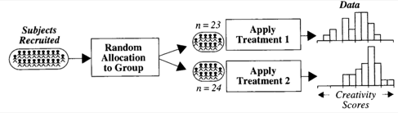
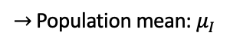
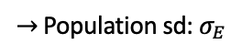
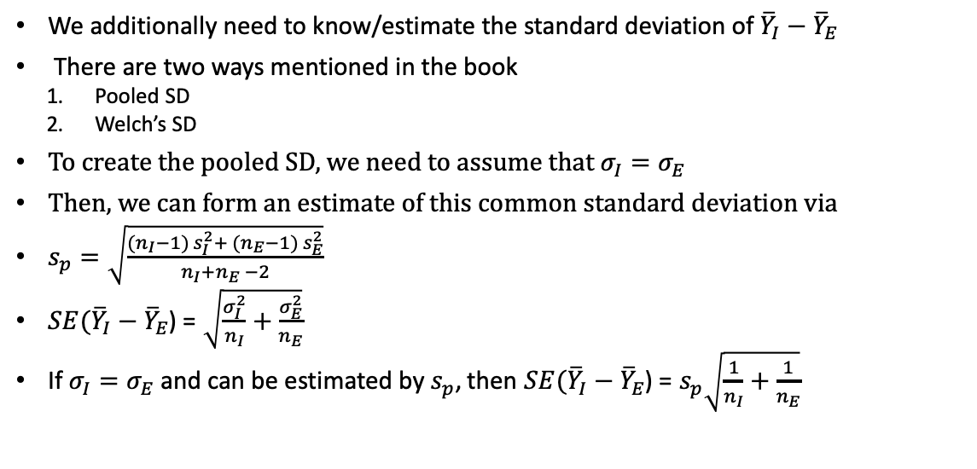
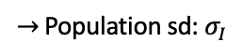
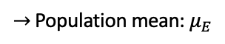
Creativity Study: Reminder
$→$ Population mean: $μ_{I}$
I
$→$ Population sd: $σ_{I}$
$→$ Population mean: $μ_{E}$
E
$→$ Population sd: $σ_{E}$
We additionally need to know/estimate the standard deviation of ${\overline{Y}}_{I}−{\overline{Y}}_{E}$
There are two ways mentioned in the book
Pooled SD
Welch’s SD
To create the pooled SD, we need to assume that $σ_{I}=σ_{E}$
Then, we can form an estimate of this common standard deviation via
$s_{p}=\sqrt{\frac{({n_{I}−1) s}_{I}^{2}+ ({n_{E}−1) s}_{E}^{2}}{n_{I}+n_{E} −2}}$
$SE({\overline{Y}}_{I}−{\overline{Y}}_{E}$) = $\sqrt{\frac{σ_{I}^{2}}{n_{I}}+\frac{σ_{E}^{2}}{n_{E}}}$
If $σ_{I}=σ_{E}$ and can be estimated by $s_{p}$, then $SE({\overline{Y}}_{I}−{\overline{Y}}_{E}$) = $s_{p}\sqrt{\frac{1}{n_{I}}+\frac{1}{n_{E}}}$
What if this assumption isn’t true?

Slide 35
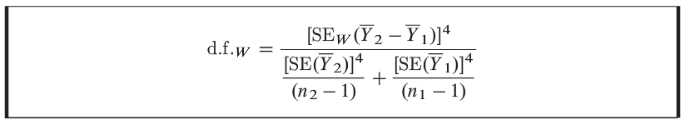
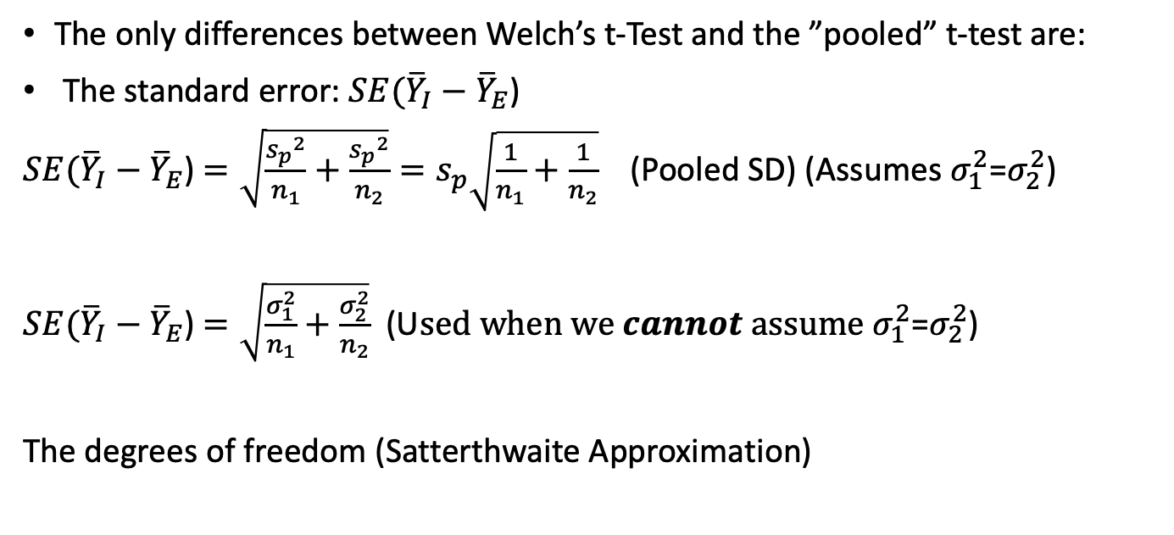
Welch’s t-Test
The only differences between Welch’s t-Test and the ”pooled” t-test are:
The standard error: $SE({\overline{Y}}_{I}−{\overline{Y}}_{E}$)
$SE({\overline{Y}}_{I}−{\overline{Y}}_{E}$) $=\sqrt{\frac{{s_{p}}^{2}}{n_{1}}+\frac{{s_{p}}^{2}}{n_{2}}}=s_{p}\sqrt{\frac{1}{n_{1}}+\frac{1}{n_{2}}}$ (Pooled SD) (Assumes $σ_{1}^{2}$=$σ_{2}^{2}$)
$SE({\overline{Y}}_{I}−{\overline{Y}}_{E}$) $=\sqrt{\frac{σ_{1}^{2}}{n_{1}}+\frac{σ_{2}^{2}}{n_{2}}}$ (U$sed when we cannot assume σ_{1}^{2}$=$σ_{2}^{2}$)
The degrees of freedom (Satterthwaite Approximation)

Slide 36
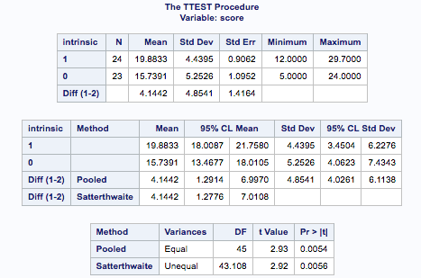
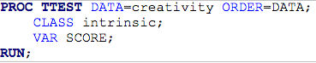
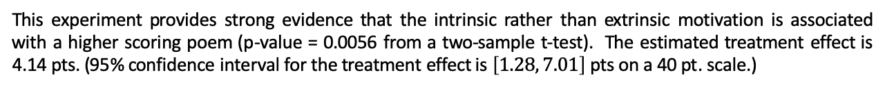
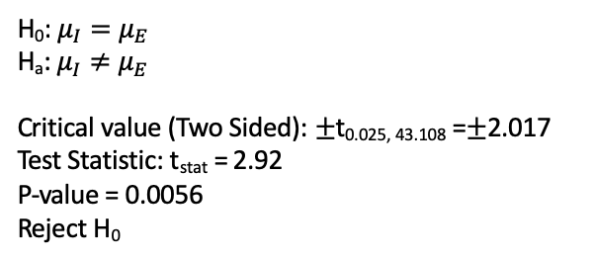
Testing Hypothesis: Welch’s t-Tools
H₀: $μ_{I}=μ_{E}$
H_{a}: $μ_{I}≠μ_{E}$
Critical value (Two Sided): $±$t_{0.025, 43.108} =$±$2.017
Test Statistic: t_{stat} = 2.92
P-value = 0.0056
Reject H₀
This experiment provides strong evidence that the intrinsic rather than extrinsic motivation is associated with a higher scoring poem (p-value = 0.0056 from a two-sample t-test). The estimated treatment effect is 4.14 pts. (95% confidence interval for the treatment effect is $\left[1.28, 7.01\right]$ pts on a 40 pt. scale.)
In R: t.test(Score~Treatment_S, data = Creativity, var.equal=FALSE)

Slide 37
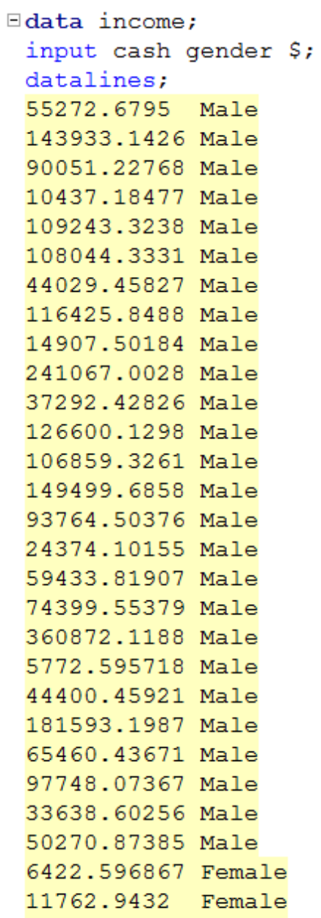
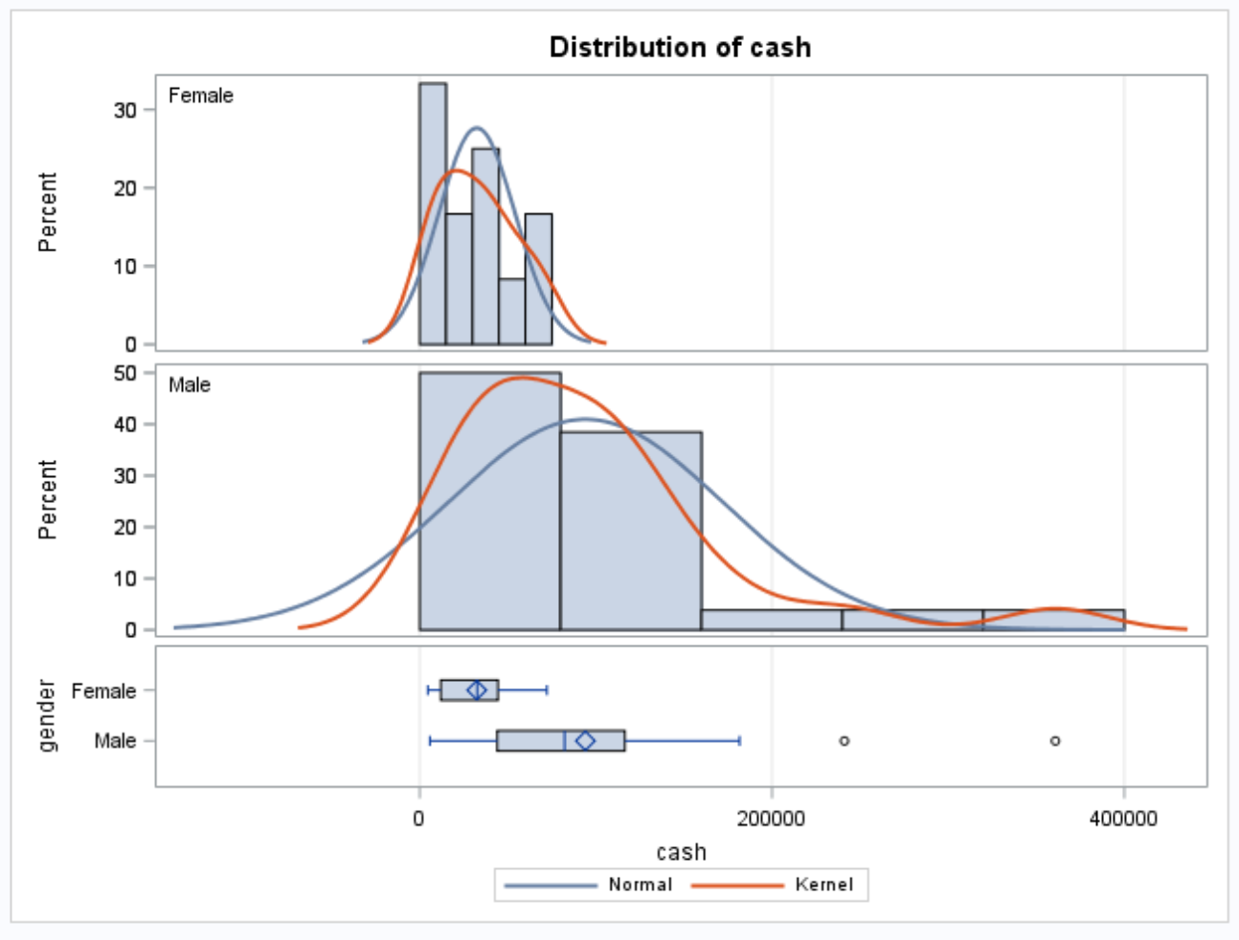
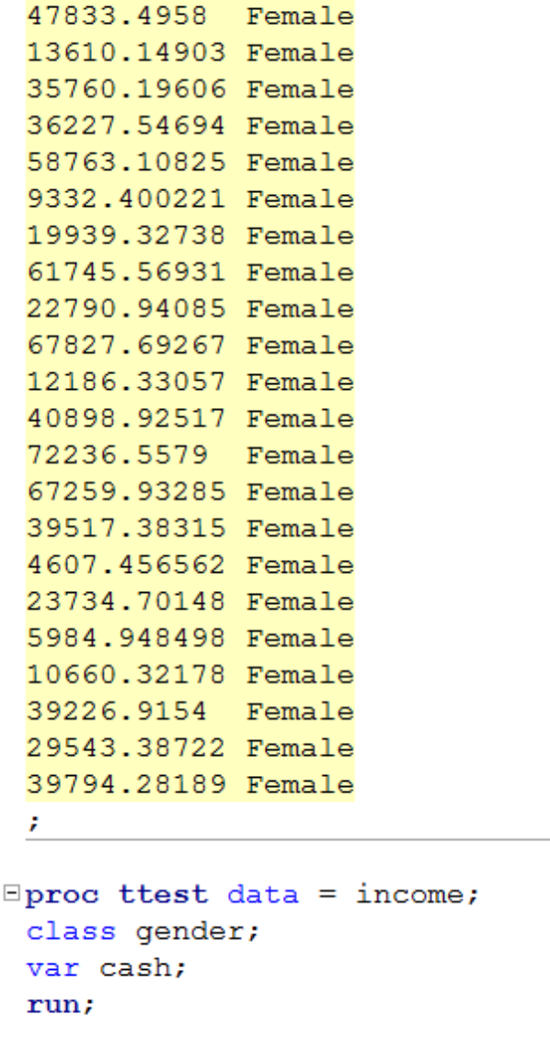
Gender Income Discrimination

Slide 38
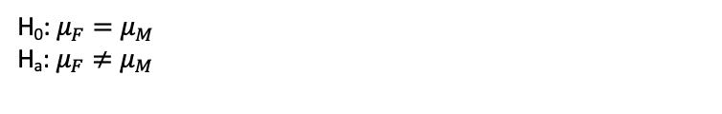
Gender Income Discrimination
H₀: $μ_{F}=μ_{M}$
H_{a}: $μ_{F}≠μ_{M}$
Strong evidence against normality, but CTL applies.
Strong evidence against equal standard deviations and different sample sizes. (They are close but the standard deviations appear to be so different that this may make a real difference.)
We will assume independence.
Student’s t-test not a good idea here.

Slide 39
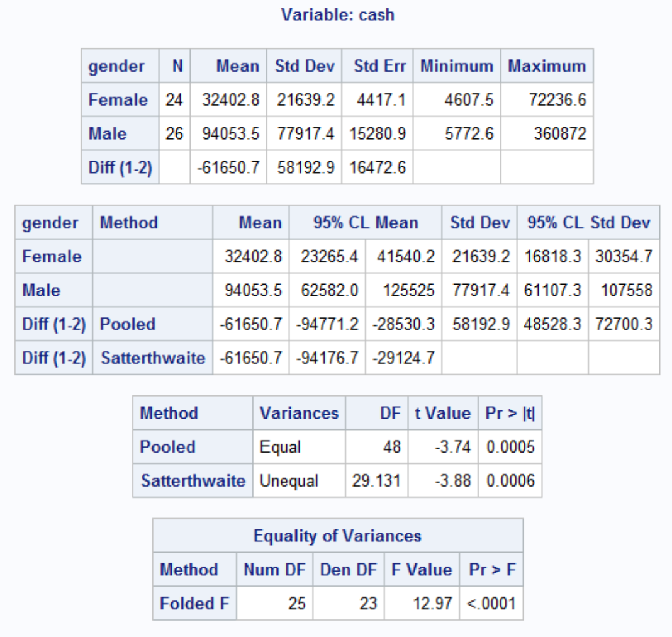
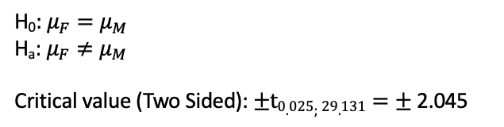
Gender Income Discrimination!
H₀: $μ_{F}=μ_{M}$
H_{a}: $μ_{F}≠μ_{M}$
Critical value (Two Sided): $±t0.025;29.131=±$2.045
Test Statistic: t_{stat} = -3.88
P-value = .0006
Reject H₀
Conclusion: There is strong evidence to suggest that the mean income of the female group is different from the mean income of the male group (p-value = 0.0006). A 95% confidence interval for this difference is ($29,124, $94,176) in favor of the males.
That is quite a difference!

Slide 40
Question 2 (2 hours)
Conduct a Welch’s two-sample t-test on the Education Data from HW 3 (untransformed). Perform a complete analysis using SAS to test the claim that the mean income of college educated people (16 years of education) is greater than the mean of those with a high school education only (12 years of education).
State the problem, address the assumptions. Be sure to support with your knowledge of theory (CLT) as well as with histograms, box plots, q-q plots, etc.
Show all 6 steps, including a thoughtful, thorough, yet non-technical conclusion. Include a confidence interval.
Include a scope of inference at the end. (You may copy and paste this from a previous HW if you like.)
Verify the Welch’s t statistic and p-value with R (using R function t.test). Simply cut and paste your R code and output. You may use: http://rcompanion.org/rcompanion/d_02.html for reference.
Would you prefer to run the log transformed analysis you ran in HW3, or do you feel this analysis is more appropriate? Why or Why not? (Make mention of the assumptions as well as the parameters that each test provides inference on. As you know, they are different.)

Slide 41




Question 2

Slide 42


Question 2
Step 1 - Hypotheses (1 point): $$H_{o}:μ_{12years}=μ_{16years} \\ H_{a}:μ_{12years}≠μ_{16years}$$
Step 2 - Identification of Critical Value (1 point): $±1.96$
Step 3 - Value of Test Statistic (1 points): $t=−9.98$
Step 4 - Give p-value (1 points): $p<0.0001$
Step 5 - Decision (0 points): Reject $H_{o}$
Step 6 - Conclusion (1 point): There is overwhelming evidence at the $α=0.05$ level of significance ($p<0.0001$) that the mean income in 2005 for people with 16 years of education is larger than the incomes for those in the study that had only 12 years of education. A 95% confidence interval for this increase is $(\$26,610.40, \$39,653.80)$.
SAS Output:
*To perform t-test;
proc ttest data = education;
class educ;
var income2005;
run;

Slide 43




Question 2

Slide 44

Question 2

Slide 45


Question 2

Slide 46

Question 2

Slide 47
End Part 2

Slide 48
End Unit 4 For Live Session Assignment

